Slide 1


Representation Learning for Deep Regression
Shihao Zhang
Supervisor: Angela Yao
Jan. 2025

Slide 2
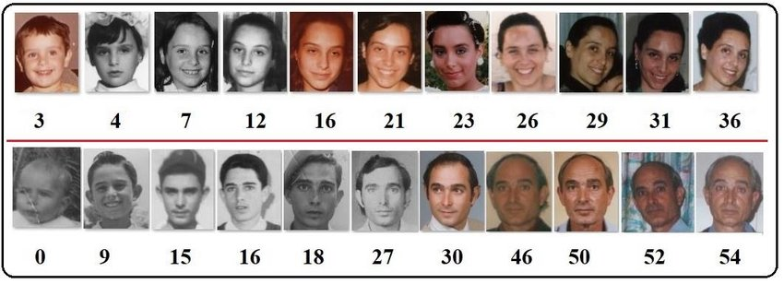
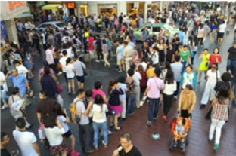
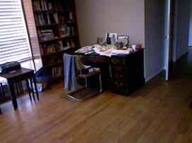
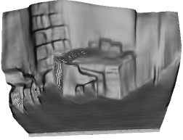
My research aims to enhance the performance of regression problems, with a particular focus on regression representation and its difference from classification representation.
Regression-type problems
Age Estimation
Counting
Depth Estimation
Others
Pose estimation
Optical flow
Super-resolution
…
277 people
Why Important
Representation learning is crucial for capturing meaningful patterns in data, while classification and regression are two fundamental tasks of machine learning. Investigating their difference in terms of representation can improve our understanding of both and benefit a wide range of regression problems.

Slide 3
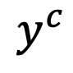
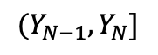
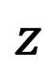
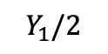
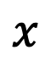
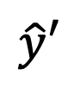
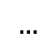
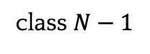
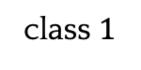
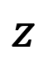
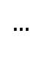
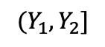
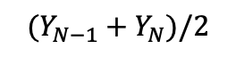
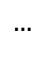
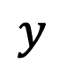
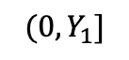
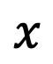
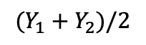
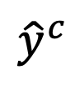
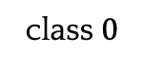
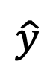
Q1 - Classification performs Better
Solving regression-type problems as classification results in better performance,
even:
Introduce discretization error
Lose ordinal relation
L2 or L1 Loss
$$x$$
image encoder
$$z$$
regressor
$$\hat{y}$$
$$y$$
$${(0,Y}_{1}]$$
$${(Y_{1},Y}_{2}]$$
$$…$$
$${(Y_{N−1},Y}_{N}]$$
input
Cross
Entropy
$$x$$
image encoder
$$z$$
$${\hat{y}}^{c}$$
$$y^{c}$$
class $0$
class $1$
$$…$$
class $N−1$
classifier
input
discretization
$$\hat{y}′$$
$$…$$
$$Y_{1}/2$$
$$(Y_{1}+Y_{2})/2$$
$$(Y_{N−1}+Y_{N})/2$$
recovery
[1] Fayyad et al. Multi-Interval Discretization of Continuous-Valued Attributes for Classification Learning. IJCAI. 1993
[2] Li et al. Monocular depth estimation with hierarchical fusion of dilated cnns and soft-weighted-sum inference. PR. 2018.
[3] Bhat et al. Adabins: Depth estimation using adaptive bins. CVPR. 2021

Slide 4

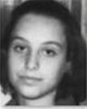


Q2 - Ordinality
Regression targets inherently exhibit an ordinal relationship.
Feature manifold
Input X
3
12
36
52
Is ordinal feature space not learned naturally? Why?
Benefits?
Feature manifold

Slide 5
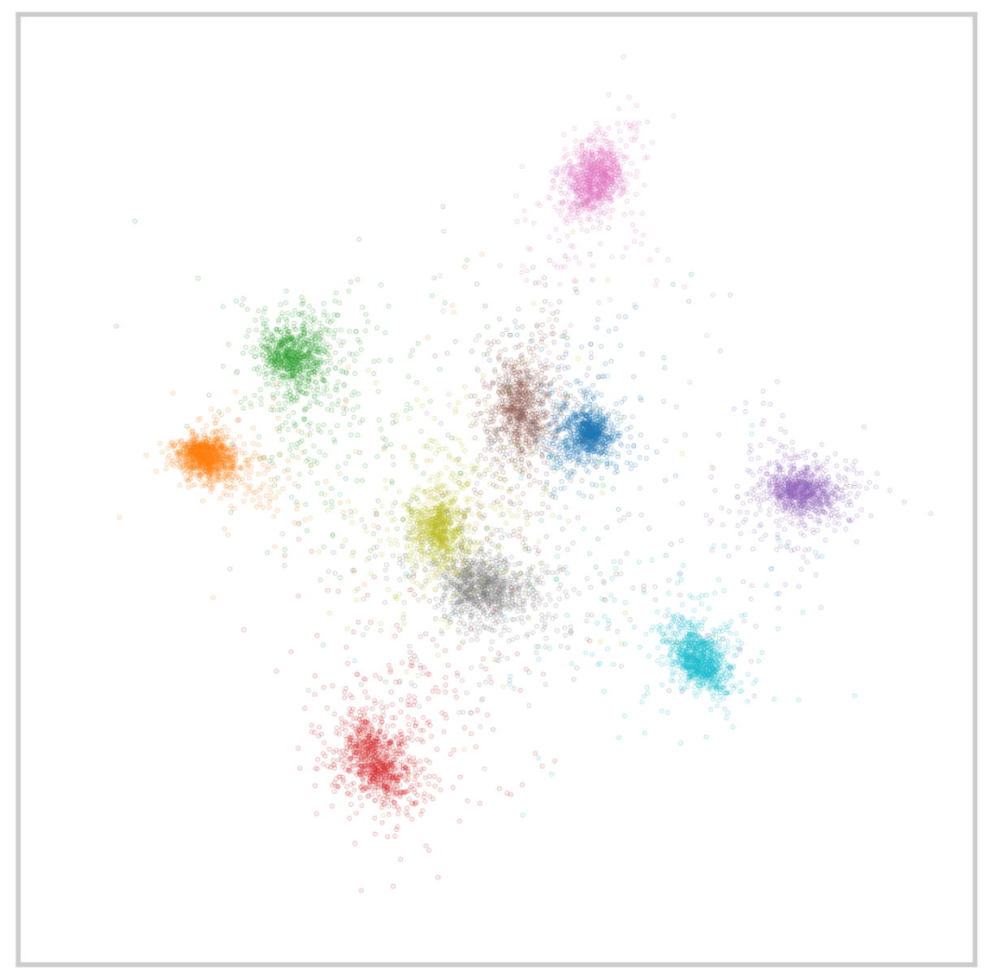
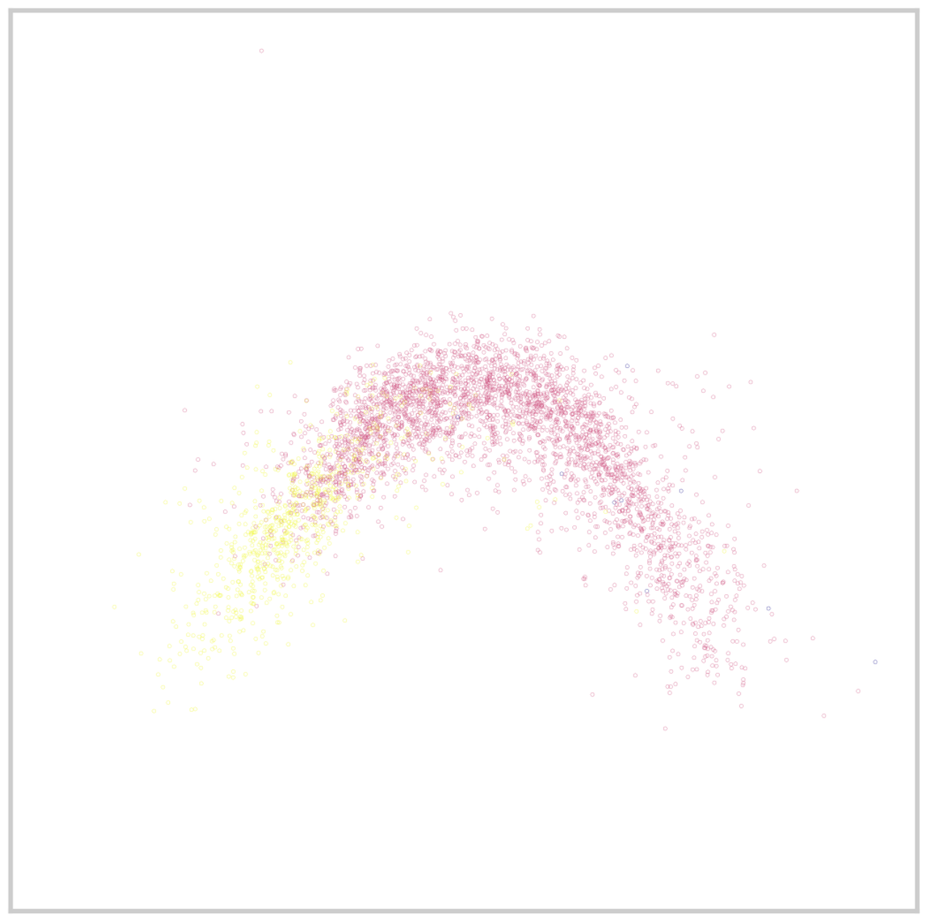
Q3 – Topology (Shape)
The representation topologies of classification and regression are different.
Classification
Regression
What topology (shape) should the representations have for effective regression?

Slide 6
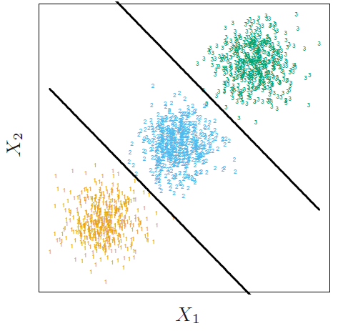
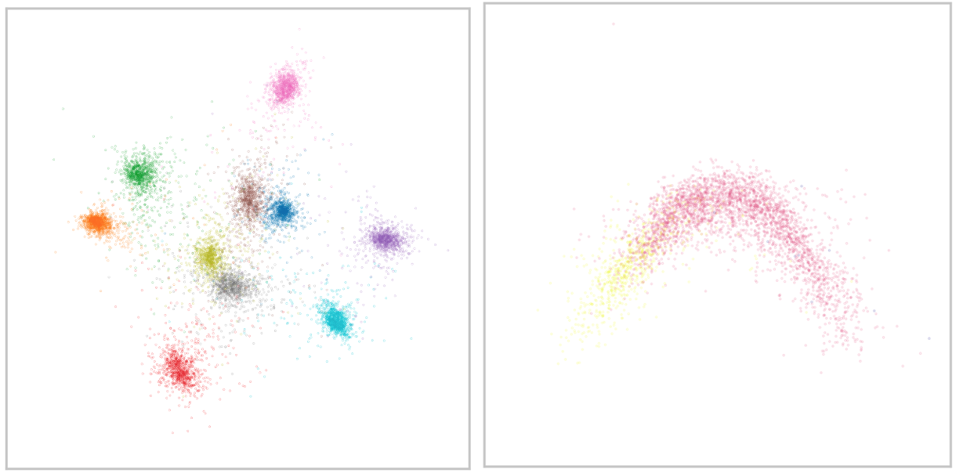
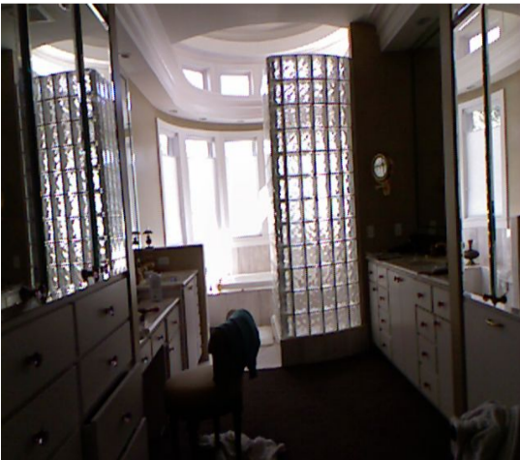
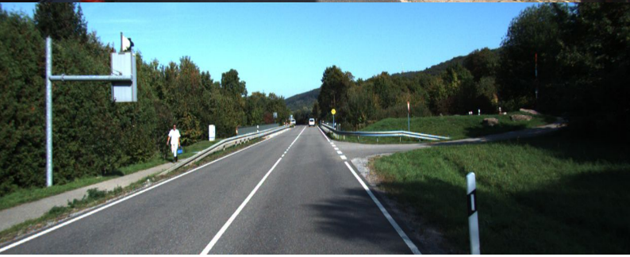
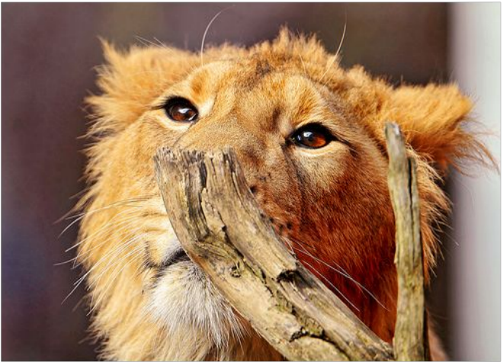
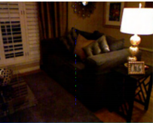
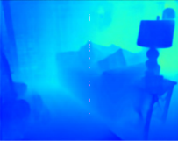
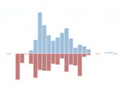
My research aims to enhance the performance of regression problems, with a particular focus on regression representation and its difference from classification representation.
Key
research questions
Question 1:
Question 2:
Question 3:
Classification
3
12
36
52
VS.
classification
regression
Regression
Different topology (shape):
VS.
- Classification: disconnected
- Regression: connected
Why classification ‘advanced’ regression
Ordinality
Desirable topology (shape) of feature manifolds
Data Challenges
Various application scenes ( e.g., Out of Distribution, Imbalanced distribution)

Slide 7
My research aims to enhance the performance of regression problems, with a particular focus on regression representation and its difference from classification representation.
Key
Research questions
Question 1:
Question 2:
Question 3:
Classification
3
12
36
52
VS.
classification
regression
Regression
Different topology (shape):
VS.
- Classification: disconnected
- Regression: connected
Why classification ‘advanced’ regression
Ordinality
Desirable topology (shape) of feature manifolds
Data Challenges
Various application scenes ( e.g., Out of Distribution, Imbalanced distribution)

Slide 8
Related Works – Task-Specific Reasons
Task-specific reasons why classification outperforms regression
Depth estimation [1]: predicting depth ranges is easier.
Pose estimation [2]: gradients are problematic or uninformative.
Local counting [3]: ground truth labels are imprecise.
Anything deeper that is not task specific?
[1] Cao et al. Estimating depth from monocular images as classification using fully convolution residual networks. TCSV. 2017
[2] K. Gu & A. Yao. Dive Deeper Into Integral Pose Regression. ICLR. 2022
[3] H. Xiong & A. Yao. Discrete-Constrained Regression for Local Counting Models. ECCV. 2022

Slide 9
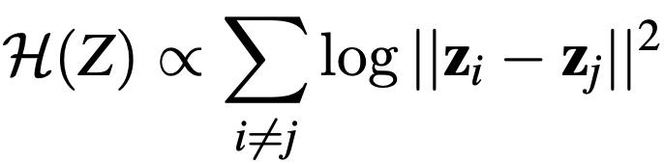
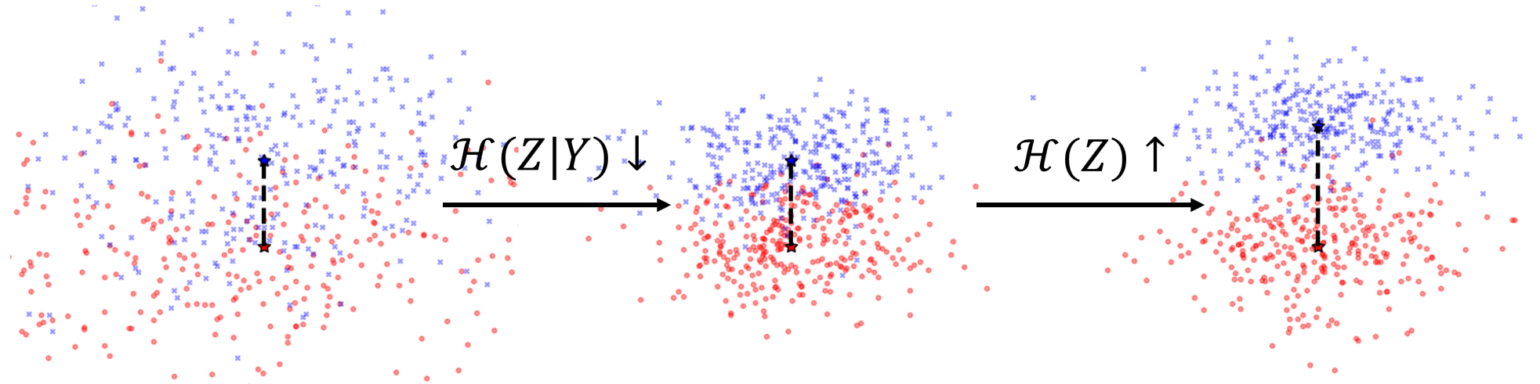
Classification Feature Space
The entropy of the feature space H(Z) is proportional to the feature distances [1]:
Classification with cross-entropy minimizes H(Z|Y) and maximizes H(Z) [2]:
Intra-class feature distances ↓:
Lower-entropy clusters, H(Z|Y) ↓.
Inter-class feature distance ↑:
Higher-entropy feature space, H(Z) ↑:
[1] Lev et al. Ica based on a smooth estimation of the differential entropy. NIPS. 2008
[2] Boundiaf et al. A unifying mutual information view of metric learning: cross-entropy vs. pairwise losses. ECCV. 2020

Slide 10
A Mutual Information Point of View
1) Regression with MSE lags in its ability to increase H(Z)
S. Zhang et al. Improving Deep Regression with Ordinal Entropy. (ICLR, 2023)
$$I\left(Z;Y\right) =ℋ\left(Z\right)−ℋ\left(Z|Y\right)$$
Mutual Information
Diversity
Tightness
2) Typical regression losses cannot reduce H(Z|Y) well
S. Zhang et al. Improving Deep Regression with Tightness. Under review of ICLR 2025 and received all positive ratings

Slide 11
Improving Deep Regression with Ordinal Entropy
ICLR, 2023
Key Contribution -- we find regression lags in its ability to increase H(Z)

Slide 12
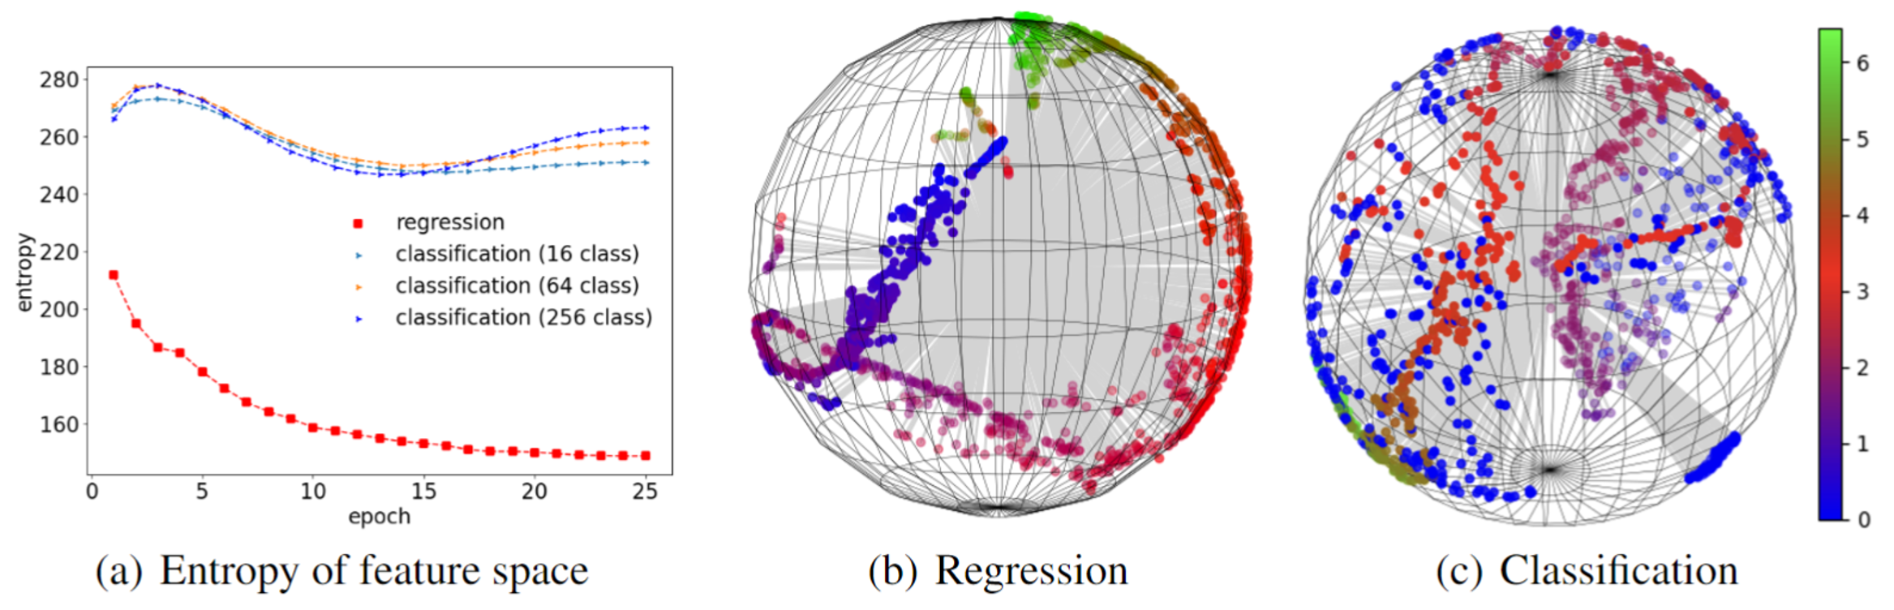
Feature Space: Regression VS. Classification
Regression representations occupy a smaller region:
implying a lower H(Z),
forming an ordinal relationship.

Slide 13
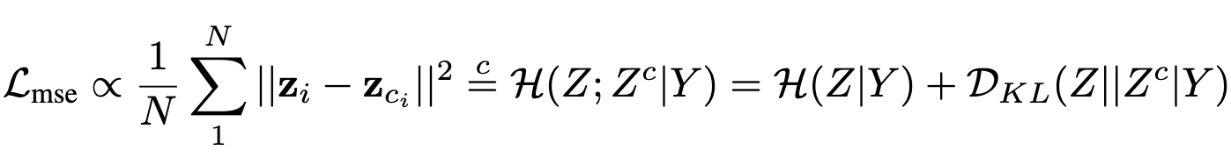
MSE is a proxy for H(Z|Y)
0 if we assume that cond. distribution is normal
equal up to multiplicative and additive constant
H(Z) remains untouched.

Slide 14
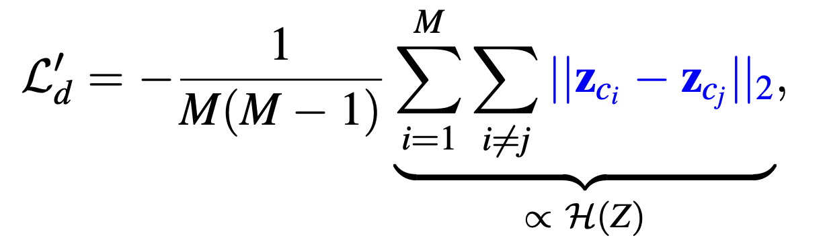
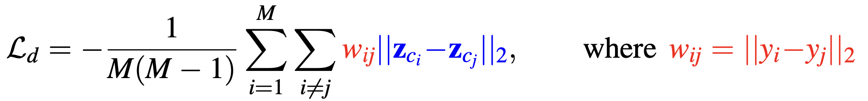
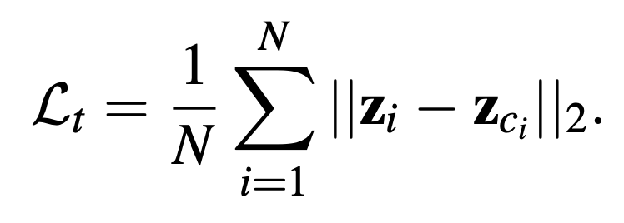
Regularizers to Increase Feature Entropy
Encouraging a higher-entropy feature space in regression by minimizing the negative distances between feature centers:
$L_{d}^{′}$ may break the ordinality in the feature space. To preserve ordinality:
To further minimize the conditional entropy H(Z|Y):

Slide 15
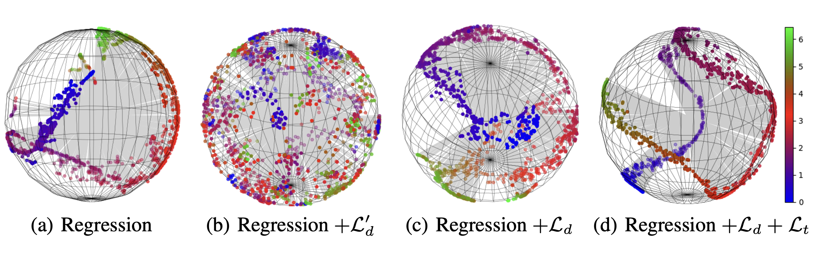
Tradeoff in Entropy VS. Ordinality
High entropy feature space is good for a higher I(Z; Y).
Increasing entropy naively destroys ordinal relationships.
Preserving ordinality again lowers entropy (Related to Q2).

Slide 16
Improving Deep Regression with Tightness
Under review of ICLR 2025
Contributions –- (Q1) reveal the weakness of regression in reducing H(Z|Y)
-- (Q2) establish connections between H(Z|Y) and ordinality

Slide 17
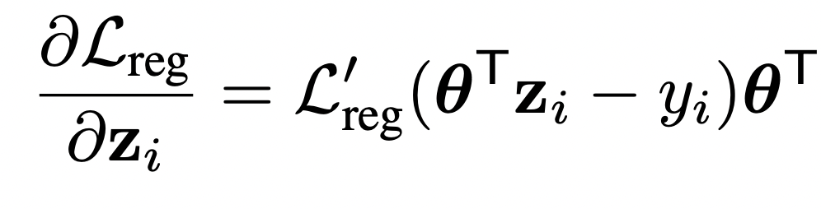
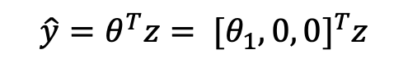
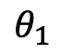
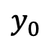
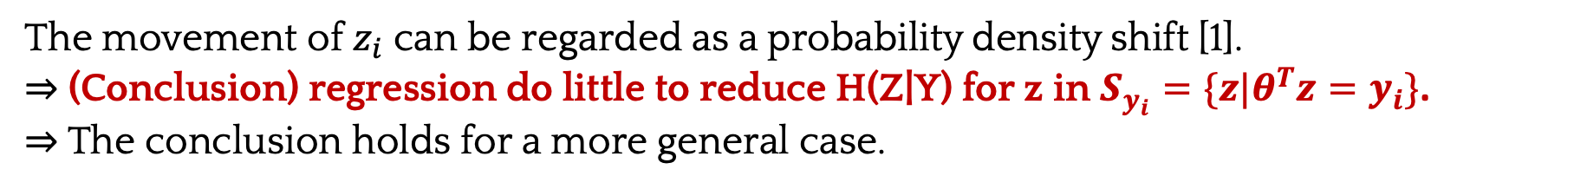
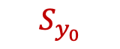






Motivation Example
For linear Regressor $θ$:
{
{
{
$$x$$
encoder
$$z$$
Regressor$θ$
$$\hat{y}=θ^{T}z$$
Vector
Scale
Vector
The gradient direction is determined solely by $θ,$ meaning $z_{i}$ is moved either towards or away from the direction of θ during training with a fixed $θ$.
$$θ_{3}$$
$$S_{y_{0}}$$
$$ℳ$$
$$θ_{2}$$
$$\hat{y}=θ^{T}z= [θ_{1}, 0, 0]^{T}z$$
0
$$y_{0}$$
$$θ_{1}$$
The movement of $z_{i}$ can be regarded as a probability density shift [1].
⇒ (Conclusion) regression do little to reduce H(Z|Y) for z in $S_{y_{i}}=\{z|θ^{T}z=y_{i}\}$.
⇒ The conclusion holds for a more general case.
[1] Sho et al. Transport analysis of infinitely deep neural network. JMLR. 2019

Slide 18

The Conclusion Holds for Differentiable Regressor
For differentiable regressor $f_{θ}$:
The gradient $\frac{∂L}{∂z_{i}}$ is perpendicular to its solution space $S_{y_{i}^{′}}$and has no effect within $S_{y_{i}^{′}}$.

Slide 19


The Conclusion Holds for a Changing $θ$
$θ$ remains almost identical throughout training, for three reasons:
(Near Zero Magnitude) The magnitude of $\frac{∂L}{∂θ}$ is ‘scaled’ by $w_{i}$ and, in reality, is often ‘scaled’ to near zero.
(Steady Direction) The effect of $z_{i}$ on the direction of $\frac{∂L}{∂θ}$ over a batch offsets each other, as $z_{i}$ tends to be distributed around $θ$.
(Limited Accumulated updates) $\frac{∂L}{∂θ}$ follow a Gaussian distribution with a near zero mean, resulting in a reduced accumulated effect.

Slide 20





Visualization of the Feature Space Updating
$$θ$$
$$S_{y_{i}}$$
Iteration 0 to 100
Iteration 1000 to 1100
Iteration 6000 to 6100

Slide 21



Classification VS. Regression
The gradient is affected by all the classifiers $θ_{j}$ (as opposed to a single single $θ$ for regression) ⇒ Classification has a higher ability to reduce H(Z|Y) for z in $S_{y_{i}}$,

Slide 22















Multi-Target Strategy
$$θ_{3}$$
$$θ_{3}$$
$$S_{y_{0}}$$
$$ℳ$$
$$S_{y_{0}}$$
$$ℳ$$
$$y_{0}$$
$$θ_{2}$$
$$θ_{2}$$
0
$$y_{0}$$
$$θ_{1}$$
0
$$y_{0}$$
$$θ_{1}$$
$$\hat{y}=[\left(θ_{1}, 0, 0\right)z]$$
$$\hat{y}=[\left(θ_{1}, 0, 0\right)z,\left(0,θ_{2}, 0\right)z]$$
Duplicate $θ$, as in classification, to compress $S_{y_{0}}$ in multiple directions.

Slide 23

Summary
Classification ‘advanced’ regression in learning a high-entropy feature space and in better reducing H(Z|Y) for z in $S_{y_{i}}$.

Slide 24
My research aims to enhance the performance of regression problems, with a particular focus on regression representation and its difference from classification representation.
Key
Research questions
Question 1:
Question 2:
Question 3:
Classification
3
12
36
52
VS.
classification
regression
Regression
Different topology (shape):
VS.
- Classification: disconnected
- Regression: connected
Why classification ‘advanced’ regression
Ordinality
Desirable topology (shape) of feature manifolds
Data Challenges
Various application scenes ( e.g., Out of Distribution, Imbalanced distribution)

Slide 25

Ordinality
Preserving the ordinality of the targets in the feature representation improves performance across various tasks.
Is preserving ordinality in the target space alone insufficient? Why should we extend this preservation to the feature space? What is the benefit?
Is ordinal feature space not learned naturally? Why?
Conclusion:
- (Informal) Preserving ordinality reduces H(Z|Y), and conversely, reducing H(Z|Y) preserves ordinality.
- An ordinal feature space is not learned naturally as regression does little to reduce H(Z|Y) in $S_{y_{i}}$.

Slide 26



Method
Self-entropic optimal transport T(S):
$$T: \left[\begin{matrix}0 & T_{12} & T_{13} \\ T_{21} & 0 & T_{23} \\ T_{31} & T_{32} & 0\end{matrix}\right]$$
The transport matrix T transports a group of samples S to itself, reflecting the similarity relationships between the samples.
$$ℳ$$
The regularizer $L_{ot}$ reduces H(Z|Y) by preserving the local similarity relationships between the target space and the feature space.

Slide 27





Experiments
Preserving ordinality has an effect similar to duplicating $θ$, which explicitly tightens the representations
Our method preserves the local relationships of the target space
Reducing H(Z|Y), improved ordinality

Slide 28
Summary
Preserving ordinality reduces H(Z|Y) and vice versa.

Slide 29
My research aims to enhance the performance of regression problems, with a particular focus on regression representation and its difference from classification representation.
Key
Research questions
Question 1:
Question 2:
Question 3:
Classification
3
12
36
52
VS.
classification
regression
Regression
Different topology (shape):
VS.
- Classification: disconnected
- Regression: connected
Why classification ‘advanced’ regression
Ordinality
Desirable topology (shape) of feature manifolds
Data Challenges
Various application scenes ( e.g., Out of Distribution, Imbalanced distribution)

Slide 30
Deep Regression Representation Learning with Topology
ICML, 2024
Key Contribution -- reveal the desirable topology of regression feature manifold

Slide 31

Topology
The representation topologies of regression and classification are fundamentally different, due to the learning objective.
- What topology (‘shape’) should the feature space have for effective regression?
Question 3:
Desirable Representation (Conclusion):
- Intrinsic dimension equals the target space
- Topologically similar to the target space
classification
regression
We arrive at this conclusion by establishing two connections:
- $H\left(Z | Y\right)⟺$ Intrinsic dimension
- $H\left(Z | Y\right), H\left(Y | Z\right)⟺$ Homeomorphism
Different topology (shape):
- Classification: disconnected
- Regression: connected
Desirable topology (shape) of feature manifolds

Slide 32

















Theoretical Analysis
Intrinsic dimension equals the target space
Bounded
Bounded
$$⟸$$
$$⟸$$
eliminate X
$$⟺$$
Generalization Error
$H\left(Z | Y\right)$
$$H\left(Z | Y\right)$$
Information Bottleneck
$$⟺$$
$$H\left(Y | Z\right)$$
Topologically similar to the target space
$$⟺$$
$Z$ is optimal if and only if:
$$Y^{′}=Y−N$$
$N$: aleatoric uncertainty
$$Z$$
is homeomorphic to

Slide 33

Encouraging the Same Intrinsic Dimension
Lowering the intrinsic dimension results in a lower H(Z|Y), implying a higher generalization ability.

Slide 34
Enforcing Topological Similarity
Feature and target spaces are topologically similar, and enforcing such similarity is helpful.

Slide 35



Experiments
Target Space
Regression Baseline
+ Our method

Slide 36


Experiments

Slide 37
Conclusion
Key
Research questions
Question 1:
Question 2:
Question 3:
Classification
3
12
36
52
VS.
classification
regression
Regression
Different topology (shape):
VS.
- Classification: disconnected
- Regression: connected
Why classification ‘advanced’ regression
Ordinality
Desirable topology (shape) of feature manifolds
Findings
‘Advanced’ in terms of
higher H(Z)
Lower H(Z|Y)
1) Homeomorphic to the target space.
2) With an intrinsic dimension equal to the target space.
Preserving ordinality reduce H(Z|Y) and vice versa

Slide 38
Future Work
Data Challenges (Complexity, Generalization, and Imbalance):
Regression representations exhibit unique properties (e.g., interpolation and extrapolation) and behave differently from classification across various scenarios. However, most research overlooks regression and focuses primarily on classification.
We lack a ‘real’ and controllable dataset for in-depth exploration of regression.
Proposals:
- Synthesize a regression dataset to investigate the impact of:
(Complexity) The complexity of the input and the output.
(Generalization) The interpolation/ extrapolation effect & Out of Distribution.
(Imbalance) Imbalanced distribution.
Data Challenges
Various application scenes ( e.g., Out of Distribution, Imbalanced distribution)

Slide 39
Thank you !
Notes:
`

Slide 40



MSE is a proxy for H(Z|Y)
$$≈$$
$$≈$$
H(Z) remains untouched.

Slide 41







Enforcing Topological Similarity
Death
$$β_{0}$$
[‘birth’, ‘death’]
The $k_{th}$ persistent homology ${PH}_{k}(S)$ is the set of ‘birth’ and ‘death’ intervals of the $k$ dimensional holes.
Calculating ${PH}_{0}(S)$ turn out to be find the minimal spanning tree.
$$α_{2}$$
$${[0,α}_{1}]$$
$$α_{1}$$
$${[0,α}_{2}]$$
$$0$$
Birth
‘birth’ and ‘death’ threshold
Enforcing topological similarity:
$$L_{t}={||Z\left({edge}_{z}\right)−Y({edge}_{z})||}_{2}^{2}+{||Z\left({edge}_{y}\right)−Y({edge}_{y})||}_{2}^{2}$$
Moor et al. Topological Autoencoders. ICML. 2021

Slide 42





Encouraging the Same Intrinsic Dimension
$$log⁡\sum{{PH}_{0}(S)}$$
$$0$$
$$log⁡\left|S\right|$$
Intrinsic dimension can be estimated as the slop between $log⁡\sum{{PH}_{0}(S)}$ and $\log\left|S\right|$.
Encourage a lower intrinsic dimension:
$$L_{d}^{′}(Z)=slop(\log{\sum{{PH}_{0}\left(Z\right)}},log⁡\left|Z\right|)$$
Encourage the same intrinsic dimension:
$$L_{d}={|L}_{d}^{′}(Z)/L_{d}^{′}(Y)|$$
Birdal et al. Intrinsic Dimension, Persistent Homology and Generalization in Neural Networks, NeurIPS. 2021

